Slide 1
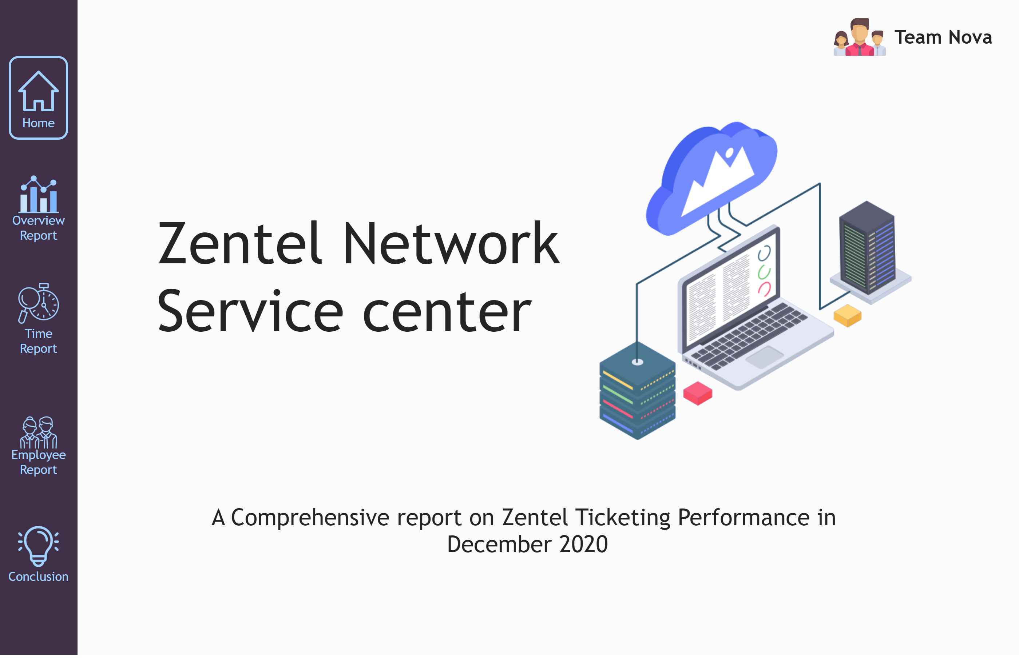
Home Page
Notes:
shape
No alt text provided
textbox
No alt text provided
image
No alt text provided
image
No alt text provided
textbox
No alt text provided
textbox
No alt text provided
image
No alt text provided
image
No alt text provided
image
No alt text provided
image
No alt text provided
actionButton
No alt text provided
actionButton
No alt text provided
actionButton
No alt text provided
actionButton
No alt text provided
shape
No alt text provided
actionButton
No alt text provided
image
No alt text provided

Slide 2
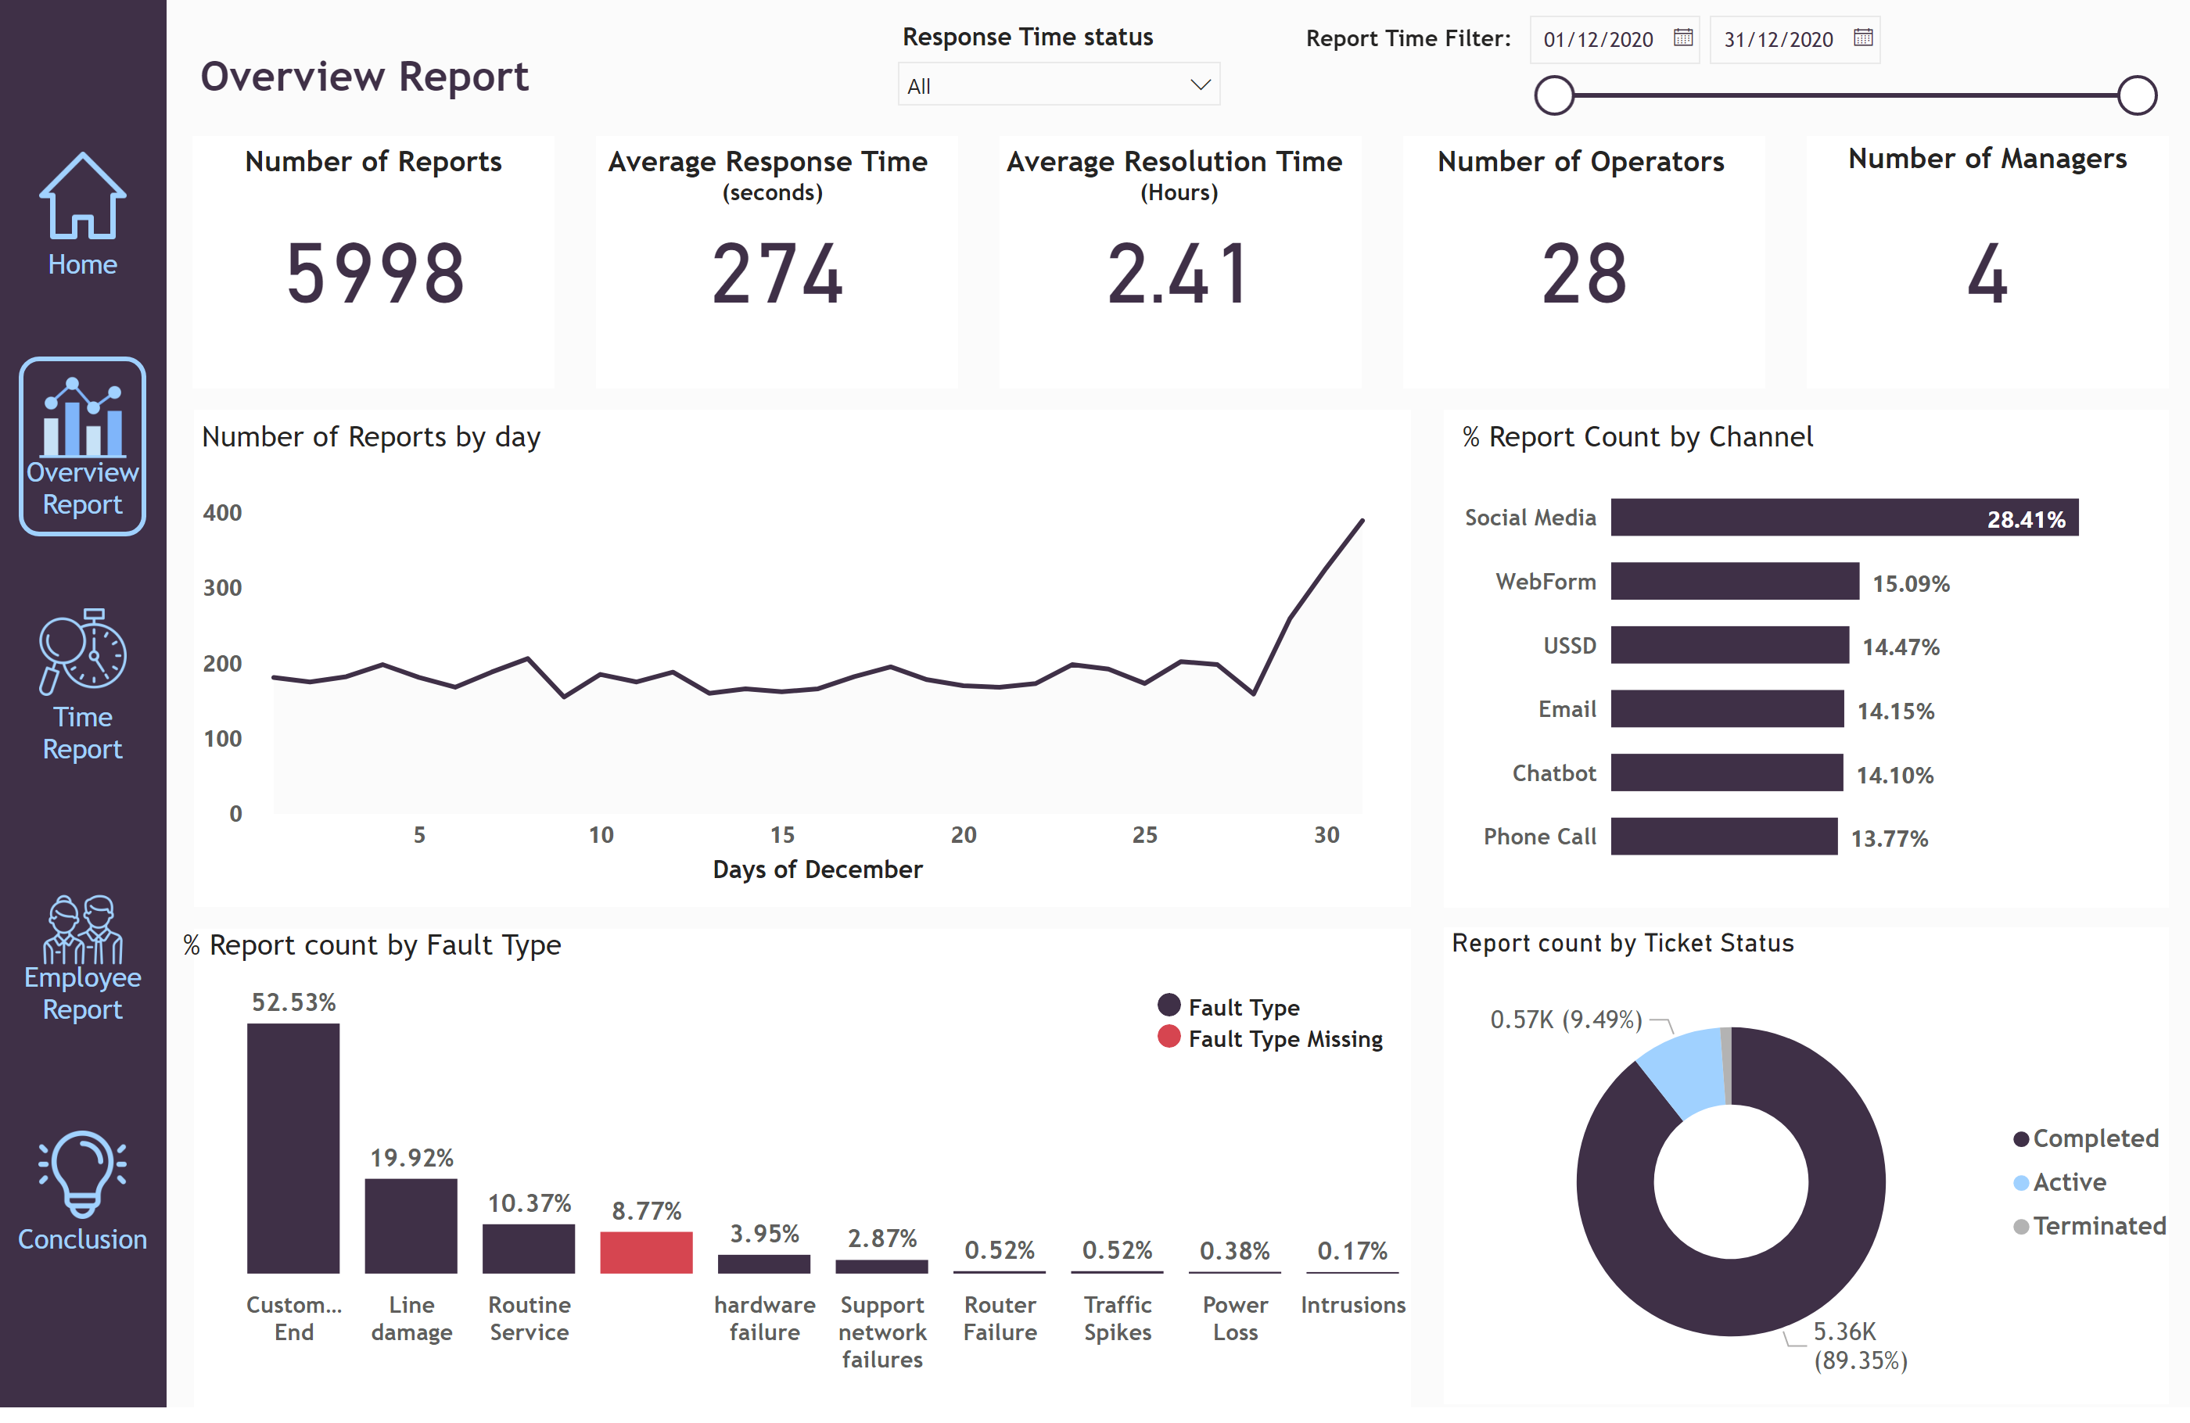
Overview Report
Notes:
shape
No alt text provided
image
No alt text provided
image
No alt text provided
image
No alt text provided
image
No alt text provided
actionButton
No alt text provided
actionButton
No alt text provided
actionButton
No alt text provided
actionButton
No alt text provided
textbox
No alt text provided
Number of Reports
No alt text provided
card
No alt text provided
card
No alt text provided
card
No alt text provided
card
No alt text provided
textbox
No alt text provided
textbox
No alt text provided
textbox
No alt text provided
textbox
No alt text provided
textbox
No alt text provided
Number of Reports by day
No alt text provided
% Report Count by Channel
No alt text provided
% Report count by Fault Type
No alt text provided
donutChart
No alt text provided
shape
No alt text provided
shape
No alt text provided
shape
No alt text provided
shape
No alt text provided
shape
No alt text provided
shape
No alt text provided
textbox
No alt text provided
textbox
No alt text provided
slicer
No alt text provided
shape
No alt text provided
textbox
No alt text provided
slicer
No alt text provided
actionButton
No alt text provided
image
No alt text provided

Slide 3
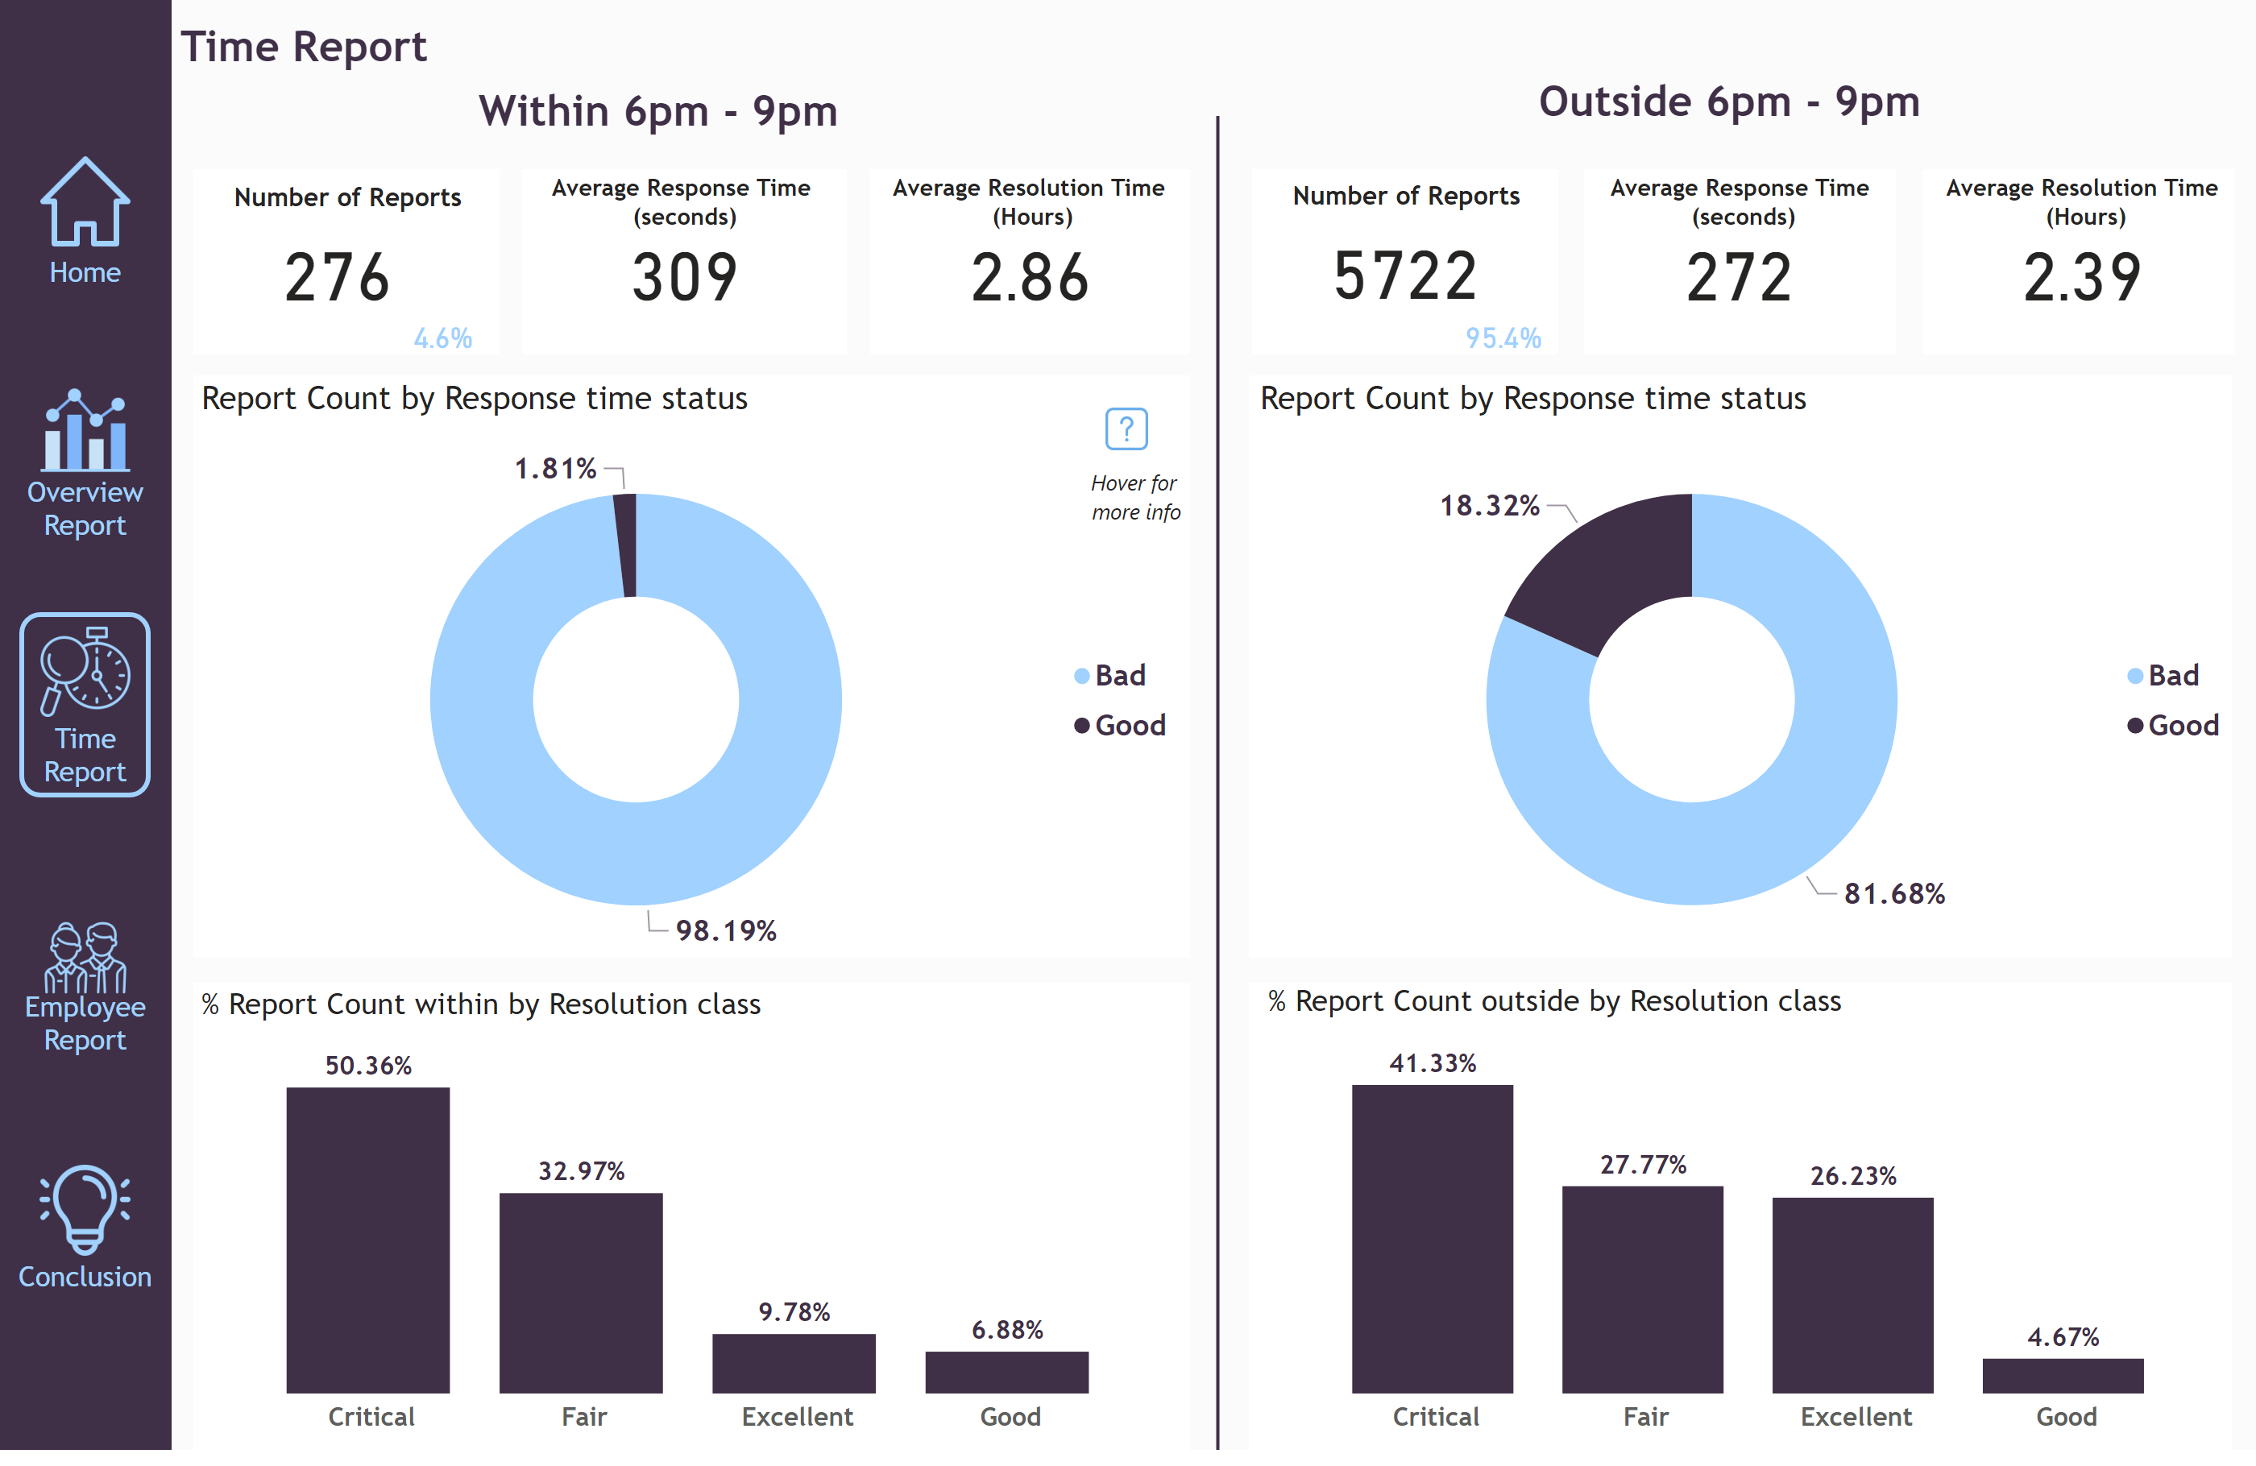
Time Report
Notes:
shape
No alt text provided
image
No alt text provided
image
No alt text provided
image
No alt text provided
image
No alt text provided
actionButton
No alt text provided
actionButton
No alt text provided
actionButton
No alt text provided
actionButton
No alt text provided
shape
No alt text provided
textbox
No alt text provided
shape
No alt text provided
textbox
No alt text provided
textbox
No alt text provided
card
No alt text provided
card
No alt text provided
card
No alt text provided
card
No alt text provided
card
No alt text provided
card
No alt text provided
card
No alt text provided
card
No alt text provided
shape
No alt text provided
shape
No alt text provided
shape
No alt text provided
shape
No alt text provided
shape
No alt text provided
shape
No alt text provided
textbox
No alt text provided
textbox
No alt text provided
textbox
No alt text provided
textbox
No alt text provided
textbox
No alt text provided
textbox
No alt text provided
shape
No alt text provided
shape
No alt text provided
shape
No alt text provided
shape
No alt text provided
% Report Count outside by Resolution class
No alt text provided
image
No alt text provided
textbox
No alt text provided
Report Count by Response time status
Good represents response time equal to or below seconds Bad represents reponse time above 10 seconds
Report Count by Response time status
No alt text provided
% Report Count within by Resolution class
No alt text provided
actionButton
No alt text provided
image
No alt text provided

Slide 4
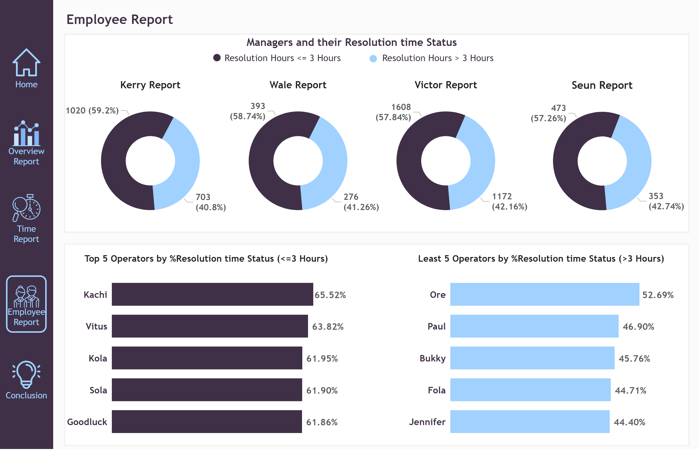
Employee Report
Notes:
shape
No alt text provided
image
No alt text provided
image
No alt text provided
image
No alt text provided
image
No alt text provided
actionButton
No alt text provided
actionButton
No alt text provided
actionButton
No alt text provided
actionButton
No alt text provided
shape
No alt text provided
textbox
No alt text provided
shape
No alt text provided
shape
No alt text provided
textbox
No alt text provided
Kerry Report
No alt text provided
Wale Report
No alt text provided
Victor Report
No alt text provided
Seun Report
No alt text provided
textbox
No alt text provided
textbox
No alt text provided
shape
No alt text provided
shape
No alt text provided
Top 5 Operators by %Resolution time Status (<=3 Hours)
No alt text provided
Least 5 Operators by %Resolution time Status (>3 Hours)
No alt text provided
actionButton
No alt text provided
image
No alt text provided

Slide 5
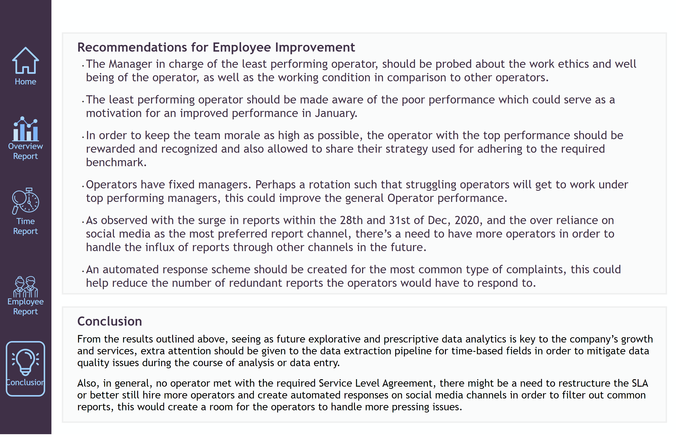
Conclusion
Notes:
shape
No alt text provided
image
No alt text provided
image
No alt text provided
image
No alt text provided
image
No alt text provided
actionButton
No alt text provided
actionButton
No alt text provided
actionButton
No alt text provided
actionButton
No alt text provided
shape
No alt text provided
actionButton
No alt text provided
image
No alt text provided
shape
No alt text provided
shape
No alt text provided
textbox
No alt text provided
textbox
No alt text provided
textbox
No alt text provided
textbox
No alt text provided

